Slide 1
Teams and Technology: How the New Breed of Attorney Operates

Slide 11
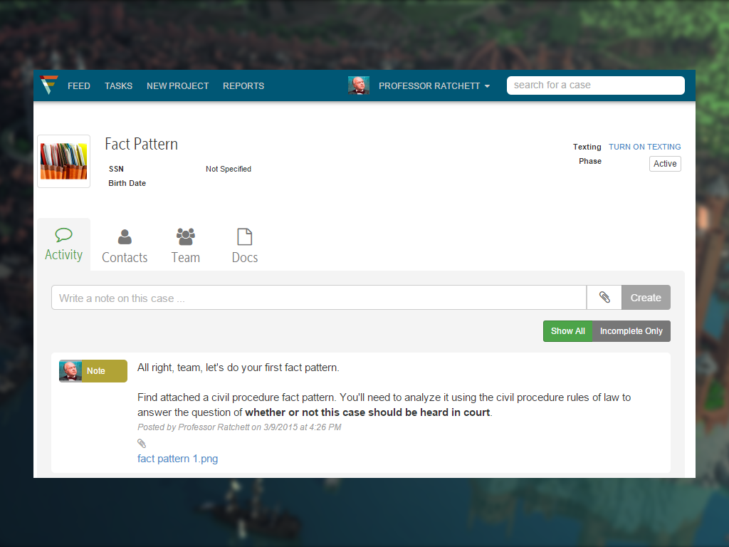
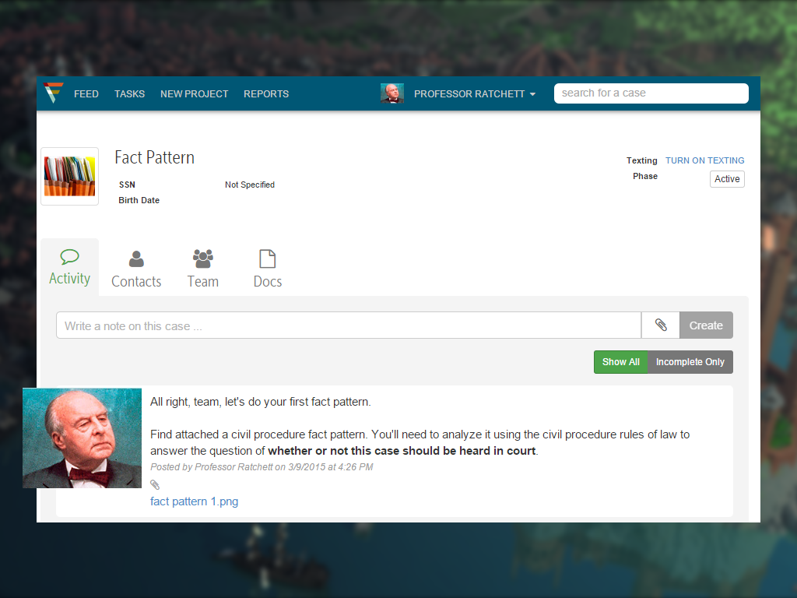

Slide 12
